Slide 1
Wireless SENSOR Network

Slide 2
WSN
What is Sensor?
A Sensor is a device that responds and detects some type of input from both the physical or environmental conditions, such as pressure, heat, light, etc.
Used in electrical and electronic applications.
Leading area of research.
Generate o/p in Electrical signal.

Slide 3
WSN
What is WSN?
Group of Base station and Multiple nodes.
Data is forwarded through multiple nodes.
Connected via Wireless Ethernet.
Monitor physical or environmental conditions
Types of sensor:
Analog Sensor
Digital Sensor

Slide 4
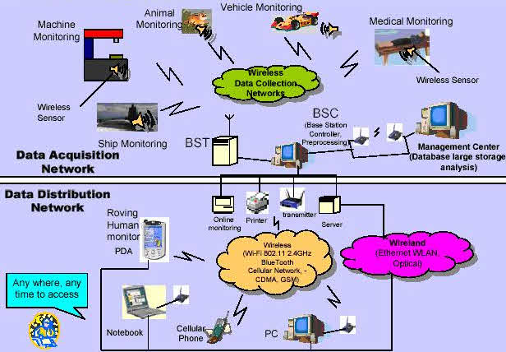

Slide 5
WSN Challenges
Characteristic requirements:
Type if service
Quality of service
Fault tolerance
Lifetime
Scalability
Wide range density
Programmability
Maintainability
Required Mechanisms:
Multihop wireless communication
Energy-efficient operation
Auto-configuration
Collaboration and in-network processing
Data centric
Locality
Exploit trade-offs

Slide 6
WSN Applications
Disaster relief applications
Environment control and biodiversity mapping
Intelligent building
Faculty management
Machine surveillance and preventive maintenance
Precision agriculture
Medicine and health care
Logistics
Telematics
Features of WSN
Tiny Size
Low Cost
Low energy consumption

Slide 7
WSN Types
Terrestrial WSNs
Underground WSNs
Underwater WSNs
Static 2D underwater
Static 3D underwater
Three-dimensional Networks
Multimedia WSNs
Mobile WSNs

Slide 8
Hardware Components of Sensor Node

Slide 9
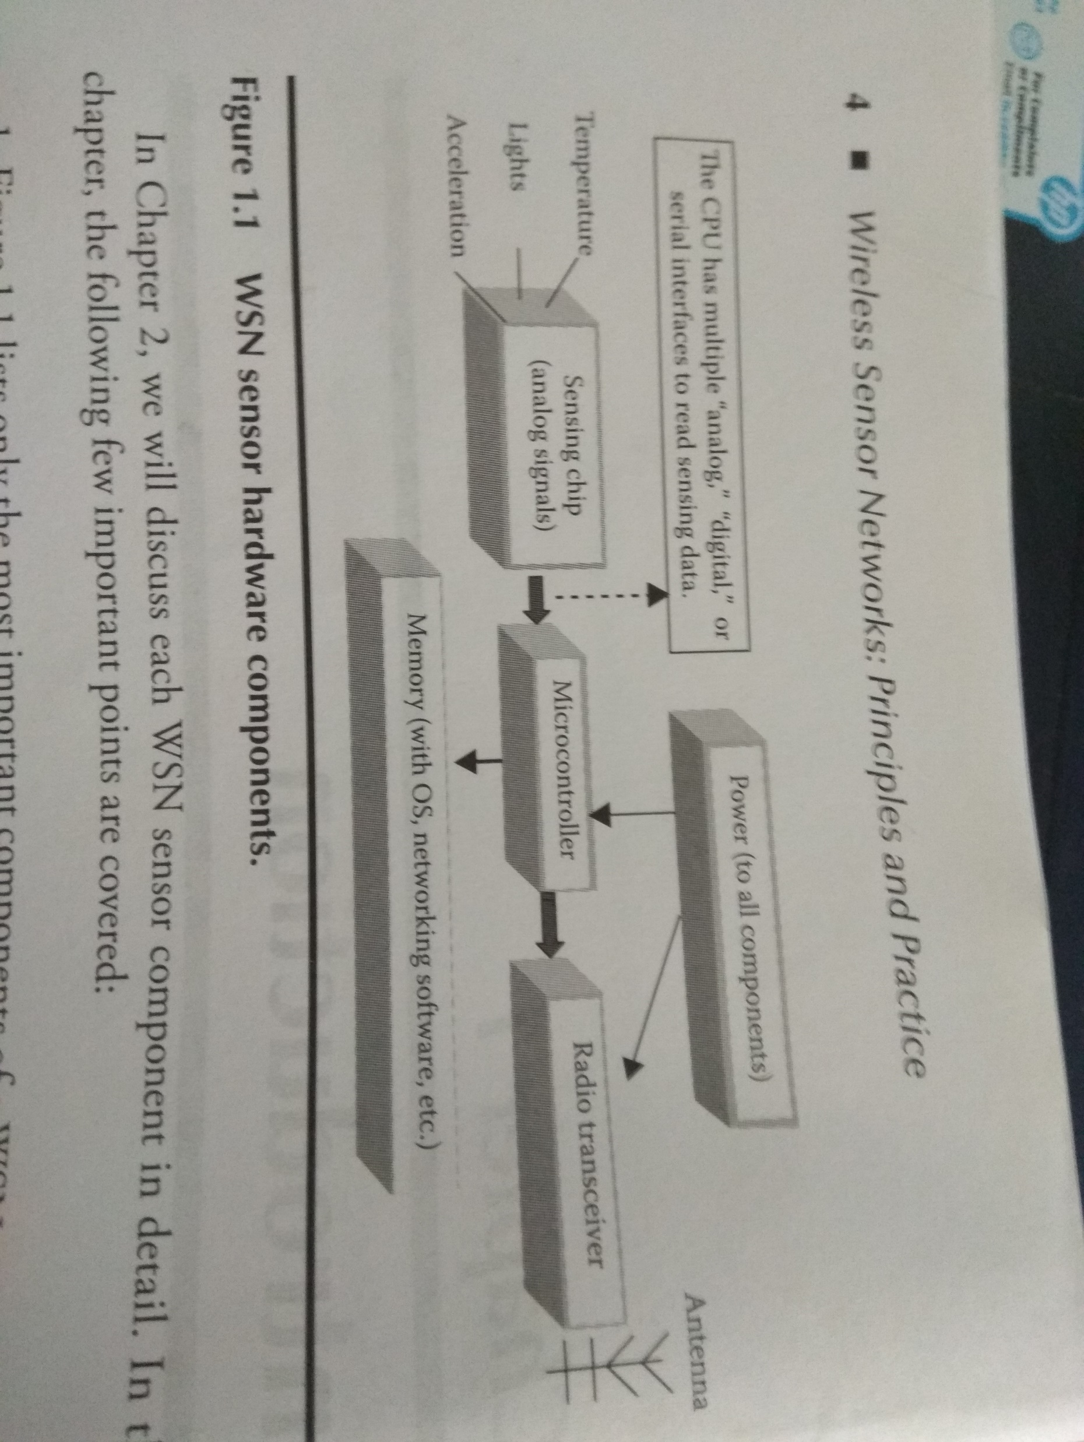
Hardware Components of Sensor Node
Microcontroller
Memory
Power
Sensor
Radio transceiver

